Slide 1
St. Jacobs BIA Annual General Meeting
Tuesday, February 19th, 2019, 6:00pm
Block Three Brewing Co

Slide 2
St. Jacobs BIA – 2019 Annual General Meeting of the membership
AGENDA
Welcome and Introduction | Edward Denyer
Summary of activities and accomplishments in 2018 | Edward Denyer
Election of new Board of management | Edward Denyer
Treasurers’ Report and Presentation of 2019 Budget | Phil Hipkiss
New initiatives for 2019 – Marketing, Beautification and Maintenance, Events | Mike Palmer Phil Hipkiss Craig Miller
Special Projects - University of Waterloo, Wilfrid Laurier University | Carrie Briscoe Edward Denyer
Q&A / Open Discussion | Bob Wilbur

Slide 3
St. Jacobs BIA - 2018 activities
BIA Management Team
Bob Wilbur – Executive Liaison
Carrie Briscoe – Coordinator
Transition
Levy Increase Project
Beautification and Maintenance
Bridge flowers and watering
Corn stalks
Winter greenery
Garbage Collection
Plans for 2019
Events
Quilt & Fibre Art Festival
Amazing Race
St. Jacobs Sparkles
Moonlight Madness
Marketing
Quarry
Social media (next slide)

Slide 4
Social Media Milestones
 | 2017 | 2018
Facebook
Followers | 5,383 | 5,811
Impressions | 1,444,130 | 1,437,498
Engagements | 11,352 | 17,414
Twitter
Followers | 953 | 1,186
Impressions | 187,157 | 228,342
Engagements | 5,708 | 6,232
Instagram
Followers | 1,716 | 2,654
Impressions |  | 351,463
Engagements | 25,168 | 33,766

Slide 5
New Board of Management (By-law states up to 10)
Edward Denyer, Eco Coffee
Craig Miller, Xclusive Elements
Bob Wilbur, Strategic Perspectives
Brittany Burgess, La Crème
Michael Palmer, Quarry
Mike Good, Good’s Garage
Phil Hipkiss, Block Three Brewing Co.
Nick Benninger, Fat Sparrow Group
Fred Redekop, Councilor Woolwich Township
Vacant

Slide 6
Treasurers’ Report
Financial Highlights
2018 Recap
2019 Budget
Summary
Spending Analysis
Approval of Budget

Slide 7
Treasurers’ Report: Financial Highlights
Increased levy from $47.6k in 2018 to $120k in 2019
Transition of services & responsibility continuing from Mercedes Corp. to the St. Jacobs BIA
Recently awarded $25k from the Main Street Revitalization Initiative, through the Township of Woolwich to contribute to the beautification plan (not reflected in the budget)

Slide 8
Treasurers’ Report: 2018 Recap*
*Note: Figures are unaudited and subject to year-end review

Slide 9
Treasurers’ Report: 2019 Budget
Process
Beautification, Marketing & Events Subcommittees met as a team and submitted their desired spend for 2019
Each line item was assessed and discussed at the Board Level until a consensus for total spend
Opportunities identified for cost savings and direct contributions from our members and supporting community

Slide 10
Treasurers’ Report: 2019 Budget
Overview

Slide 11
Treasurers’ Report: 2019 Budget

Slide 12
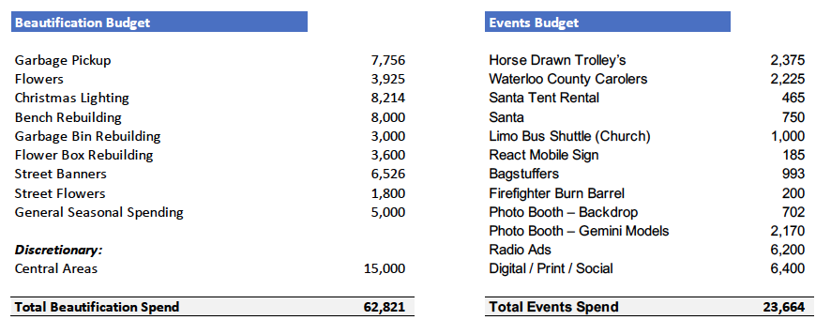
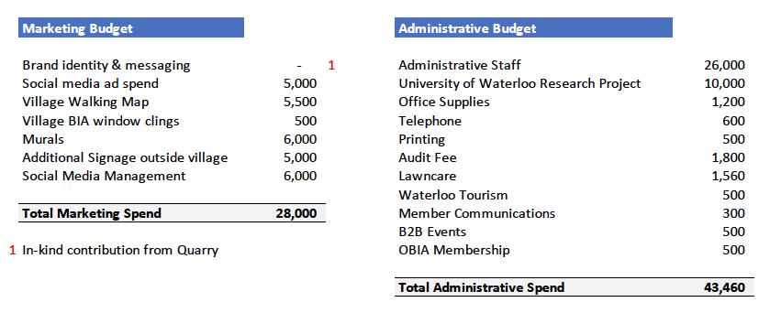
Treasurers’ Report: 2019 Budget
Total 2019 Budgeted Spend 157,945

Slide 13
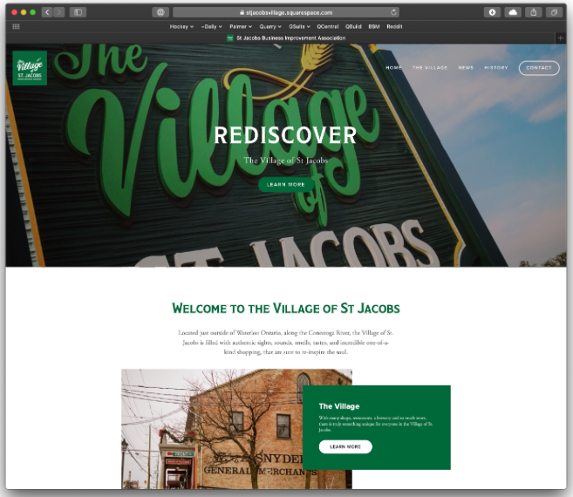
Marketing
Introducing our new website!
www.stjacobsvillage.com
If you haven’t already, please send in your info

Slide 14
Beautification and Maintenance
New garbage/recycling bins, benches, and bridge planters
Ontario Main Street Revitalization Fund
King Street Beautification:
Spring/summer flowers
Winter decorations and greenery
Banners – Waterloo North Hydro (see next 3 slides)

Slide 15
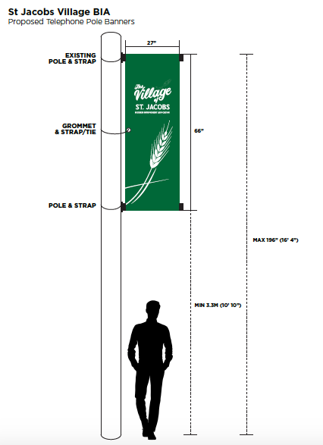
Beautification and Maintenance

Slide 16
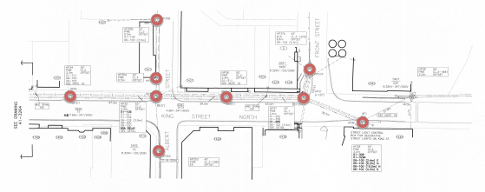
Beautification and Maintenance

Slide 17
Beautification and Maintenance

Slide 18
Events
2018 Sparkles Update
New last year was the Photobooth (located at the Mill) and Lutheran Church Tree Lighting
1015 ballots were filled out for the gift basket draw
Survey responses were all very positive and supportive of the event
Weather not favourable on the Thurs evening (hence Village saw a decrease in foot traffic)
Additions for 2019 Sparkles
Staying Open late until 9pm on Sat
Possible (Father Xmas)
More activities spread towards the south end of King Street
More food options throughout the Village ‘Pop-Ups’

Slide 19
Events continued
Events for 2019
Quilt and Fibre Festival
Summer Solstice
St. Jacobs Sparkles
NEW (Large Scale Event for 2020)
Planning needs to start immediately

Slide 20
University of Waterloo Community Partnership
Tourism department, Recreation and Leisure Studies, University of Waterloo
Involvement in REC 280/480 course Winter term
Research goals and objectives
Data collection:
One-on-one interviews with key stakeholders in St. Jacobs
Open-ended survey with St. Jacobs residents
Community engagement workshops
Currently seeking and applying for grants to fund the pedagogical and community engagement research to sustain both projects
Announce Partnership Launch Party - March 13th 6pm at Block Three Brewing Co.

Slide 21
Wilfrid Laurier University
Partnership with Lazaridis School of Business and Economics, MBA program.
The main objective of this project is to create the strategic plan for St. Jacobs Village to help attract recurring visitors from the surrounding areas.
Interviews and surveys will commence in the upcoming month.

Slide 22
Q and A: Open Discussion

